Slide 2
NextAIRE Summer School
“Translating Science Into Policy”
Sarajevo, Tuesday 8th of September, 2026
Jon Matthew Switters – The Lisbon Council

Slide 3
“All issues are political issues…………”
- George Orwell
Notes:
I wanted to start today with a quote from George Orwell where he once said “All issues are political issues”. Although will be using this in a slightly different context as to how George orifinally frame this. Hopefully this will become evident by the end of my presentation.

Slide 4

The Challenge
93.5 billion EUR invested from 2021-2027 in the Horizon Europe R&I Programme.
How can we ensure that results generated through this investment do not simply sit on the shelf?
Source: AI-generated image, OpenAI ChatGPT, 2026.
Notes:
93.5 billion EUR have been invested in the 2021-2027 cycle of the Horizon Europe Research and Innovation programme.
What can we do to ensure that this investment generates a positive impact on society?
For me, this is one of the greatest challenges of working in European-funded projects.

Slide 5

Why Is This Important?
Large investment of money = duty to provide Return on Investment (RoI)
Large amount of high-level research = Tremendous potential to generate positive change.
Source: Image by rawpixel.com on Magnific
Notes:
An important point to keep in mind that this is 93.5 billion EUR of public money – it is our duty to ensure that things generates a positive impact for academia, civil society, industry, policy….
There is a tremendous amount of high-level research being carried out – great potential to achieve this positive impact.
One of the ways of ensuring that your results generate this positive change is through influencing policies with the evidence or results or solutions that you have generated.

Slide 6

A Solution?
Translating scientific evidence into effective policy is one solution to ensure the long-lasting impact of the research and innovation projects.
Source: Image by KamranAydinov on Magnific
Notes:
One of the ways of ensuring that your results generate this positive change is through influencing policies with the evidence or results or solutions that you have generated.
Today we will focus on policy – although we are fully aware that there are other ways of ensuring that the results from projects have the desired impact and last over time – for example contributions to standards / research papers.
We will do this in the scope of the Horizon Europe Research and innovation programme although a lot of these examples and ideas can be transferred to other initiatives.

Slide 7

Why Is This Important?
<a href="https://www.magnific.com/free-photo/business-people-are-brainstorming_18411516.htm">Image by rawpixel.com on Magnific</a>
How Can We Embed Policy Into Projects?
Notes:
So how can we do this? How can we embed policy into our projects?

Slide 8
Project Design Phase
Design your project work plan with policy in mind.
Dedicate a project task or even a work package to this end.
This work is essential to the project’s success and is not just an “Add-on”
Notes:
In order to do this, policy should be kept in mind during the project design at the proposal writing phase.
This way, you will ensure that adequate resources are put into place to carry out this task and it isn’t just seen as an “add –on”

Slide 9
Project Execution Phase I/II
Establish a policy team / working group in your project.
Discuss what Key Exploitable Results (KER) will be generated during the project which could have an impact on policy.
Identify potential policy stakeholders: Local, regional, national, European, international…..
Use your own network / project partners’ networks – Any low hanging fruit?
Notes:
Establish a policy team and ensure the involvement of representatives from the other main work packages in the project – particularly communication and dissemination and the scientific work packages.
Discuss what results will be generated and which could have an impact on policy.
Brainstorm and identify potential political stakeholders:
Consider what level is most relevant to your project:
Local
Regional
National
EU
International
Use your own network/reach out to project partners – any direct connections/low hanging fruit?

Slide 10
Project Execution Phase II/II
Engage stakeholders in the project from early on – What are their needs? What are the hot topics?
Plan regular engagement activities and feedback loops.
Ensure closure at the end of the project through the presentation of results.
Notes:
Engage political stakeholders early: Ask what their needs are? Ask what the hot topics are? Identify any timelines for current policy initiatives.
Plan regular engagement and feedback loops:
What frequency can you reach out the policy stakeholders.
Ask for feedback.
Show how their input is begin considered
Ensure there is closure at the end of the process through the presentation of results and findings.

Slide 11
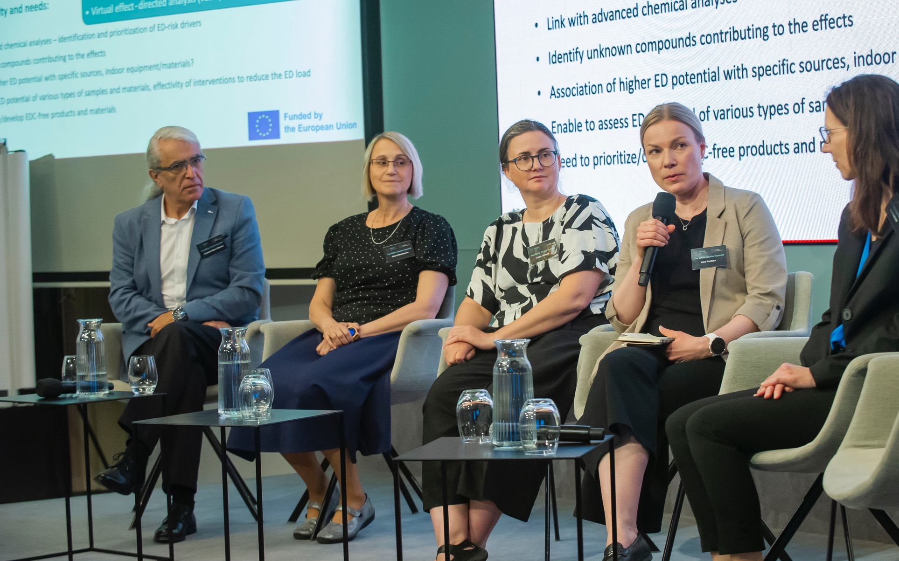
What Tools Can We Use to Reach, Engage & Inform Policy Stakeholders?
Notes:
So how can we do this? How can we embed policy into our projects?

Slide 12
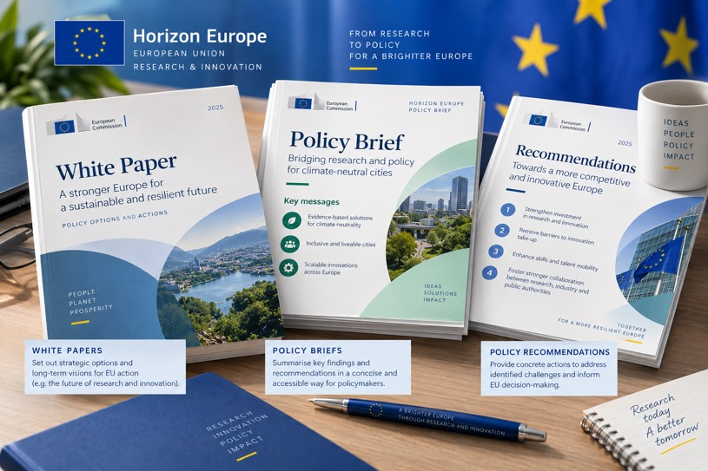
Documents & Reports
The type of document or report depends on your results & the stakeholders you are addressing:
  White/green papers
  Policy Briefs
  Recommendations etc.
Structure is key….
  Less is more
  Highlight key points with statistics + images
Source: AI-generated image, OpenAI ChatGPT, 2026.
Notes:
Different policy documents should be chosen according to the results you have and the stakeholders you are reaching out to.
White papers: A white paper is an authoritative, in-depth report or guide that explains a complex issue and presents a specific solution or philosophy. It is designed to educate readers, help them solve a problem, or guide their decision-making process.
Policy briefs
Recommendations
Structure is key:
Short to the point - Less is more
Visual where possible
Use statistics to highlights main results and messages.

Slide 13
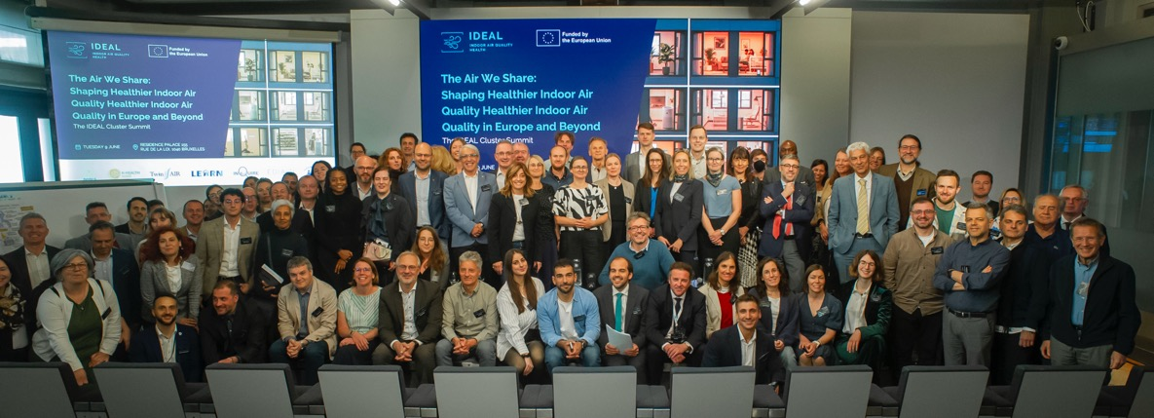
Events
Events are a fantastic way to engage stakeholders, gain feedback and present results:
  Round tables & High-level lunches
  Large-scale conferences & summits
  Workshops at key conferences / Events at the European Parliament
Source: IDEAL Cluster Summit,
Brussels, June 2026.
Notes:
Events are a great way to engage representatives, gain feedback and present results. The type and format of events should be adapted to the results you have and the stakeholders you want to reach.
Webinars
Round tables
High level lunches
Large-scale events – Summits
Workshops at key conferences
Events at the European Parliament

Slide 14
Timing is key….
Focus on more targeted, smaller scale engagement in the beginning of the project, building towards larger scale activities when you have results to present.
Don’t engagement activities too late in your project – no time for feedback.
Involvement of Members of European Parliament (MEPs) – Check their political schedule!
Side conference at a third-party event? – When does the call for workshops open?
Notes:
The timing of your engagement activities is key:
Large policy event too early in the project – not much to give
Too late in the project – no time to adapt your findings according to input from stakeholders.
If you are planning to do an event that involves MEPs – consider the political calendar – Luxembourg once a month.
Same for events elsewhere – choose a month with less activity to maximise participation.
If you want to organise a side event at a conference – when does the call open?

Slide 15
Choose The Location Wisely
Brussels is a go-to option for policy related events at European level……however, other options may better suit you…
Is there a thematic conference taking place somewhere where you could organise a workshop or event?
Are your results specific to a local context, would a local or regional event be better? E.g. smart city projects
Busy period – better to organise the activity online?

Slide 16
Accessible Events & Documents
Events:
  Ask participants about accessibility needs before the events.
  Schedule regular breaks.
  Ensure all participants use a microphone when speaking.
  Provide automated captions for online events.
Documents:
  1.5-line spacing.
  Unjustified text.
  Alternative Text Descriptions.
  Use the accessibility checker in Word.
This is not an exhaustive list

Slide 17
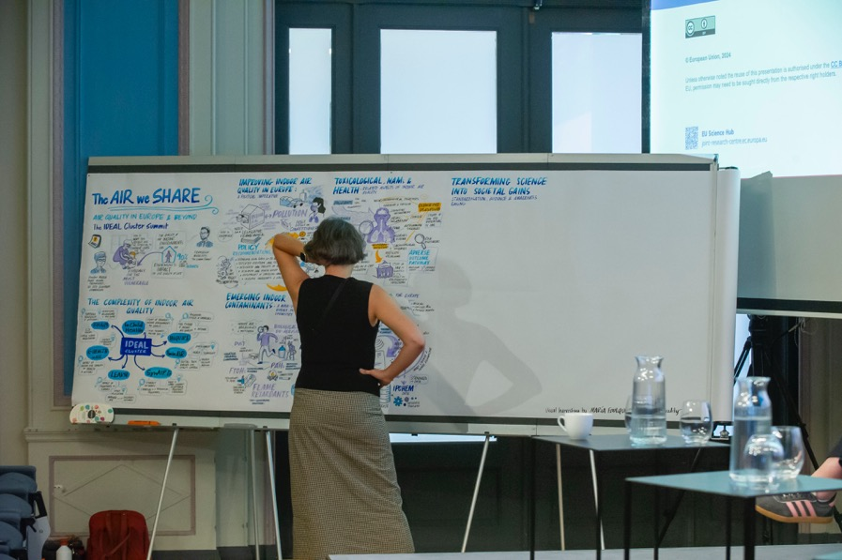
Keep Your Audience Engaged
It is important that policy activities do not become a monologue. It is called “engagement” as it should be a two-way conversation.
Tools to successfully engage your audience include:
  Online questionnaires/polling
  Breakout groups/discussions
  Visual harvesting
  Q&A sessions
Source: IDEAL Cluster Summit, Brussels, June 2026.

Slide 18


Slide 19
1. How many of you have participated in a Horizon Europe / EU-Funded Project?

Slide 20
2. Please keep your hand raised if you coordinated that project?

Slide 21
3. Can anyone share any examples of a project or initiative has generated policy change?

Slide 22
4. Would anyone like to share any tools that they have used to engage policy makers?

Slide 23
Key Takeaways
Collaboration between different expertise in a project is key – bridge the science-policy gap.
Policy should be built into project design and not just an afterthought.
Policy engagement goes beyond dissemination and communication of project results.
Flexibility is the key to success – policy design and implementation follows its own schedule – we should adapt!
Notes:
Collaboration between different stakeholders is key – bridge between scientific and policy/comms teams and everyone in between.
Policy impact should be a consideration from the get-go and not just an afterthought.
Policy engagement goes beyond dissemination – it takes results that have been disseminated and ensures that they reach the right policymakers in the correct format at the correct time.
Be flexible – Policy design often follows its own timetable – be willing to adapt if you can influence a policy.

Slide 24
Thank You!
Name: Jon Switters
Organisation: The Lisbon Council
Email: jon.switters@lisboncouncil.net
Website: https://lisboncouncil.net/

